Slide 1
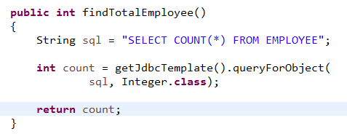
Total number of rows
How to query a total number of rows from database

